Slide 1

Department of Computer Science and Engineering
Final Project Review
Papaya Fruit Disease Classification using
Deep Learning Techniques
Presented by
CS20B1002 - Abhishek Tirkey
CS20B1060 - Ujjwal Kumar
CS20B1065 - K Vivek Kumar
Guided by
Dr. P Kumaran
Assistant Professor, CSE

Slide 2
Agenda
Summary
Introduction
Literature Review
Gaps in Literature
Motivation
Objectives
Implementation
Proposed Architecture
Result and Analysis
Timeline
Conclusion
Future Work
References
2

Slide 3
Summary
Papaya, a tropical fruit cherished for its delectable taste and nutritional value, faces a substantial threat from various diseases that can significantly diminish crop yields. Conventional methods for disease detection often prove inefficient and imprecise.
In response to this challenge, our project is dedicated to harnessing the potential of machine learning to revolutionize papaya farming. We aim to develop a robust system employing advanced algorithms and data-driven techniques to accurately classify different diseases in papaya fruits. This innovative solution has the potential to provide farmers with timely insights, enabling them to safeguard their crops and ensure more abundant yields.
Throughout this project, we will delve into the methodologies, tools, and outcomes of implementing Deep Learning Techniques for papaya fruit classification, thereby contributing to the progress of sustainable agriculture.
3

Slide 4
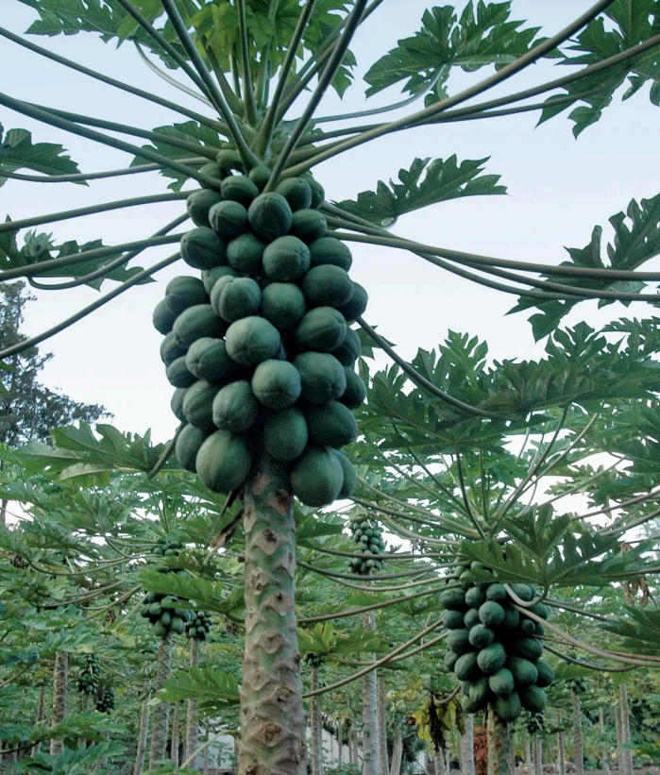
Introduction
Papaya fruit is known for its vibrant orange flesh, is a tropical delicacy. Rich in vitamins, minerals, and enzymes like papain, it offers a sweet, tropical flavor and numerous health benefits.
Health Benefits
Heart Health
Immune System
Cholesterol
Skin
Digestion
Cancer
 |  | 4

Slide 5
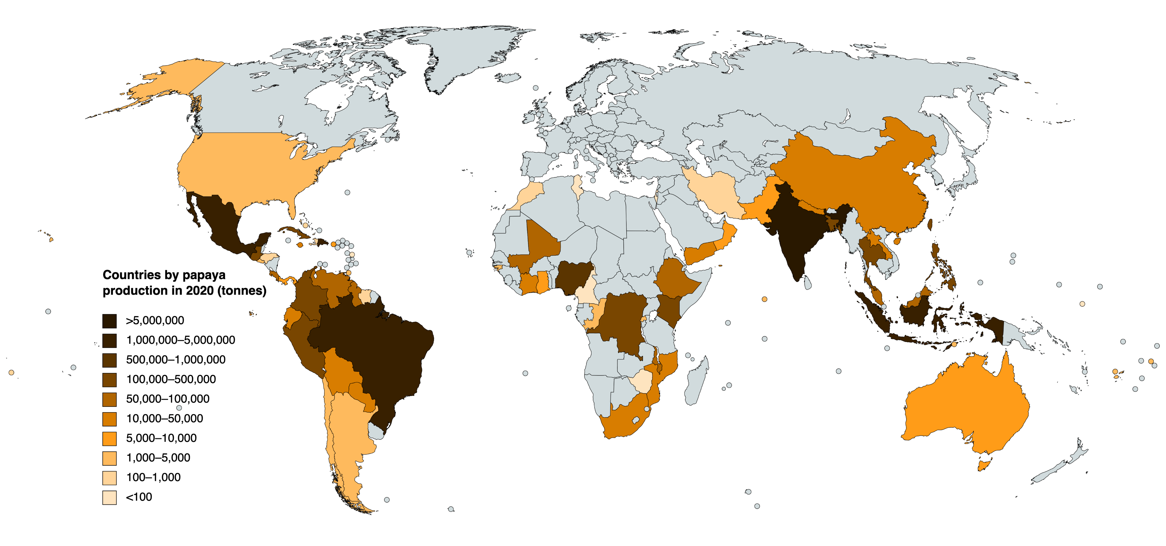
Introduction
Production of PAPAYA in World
India leads the world in papaya production.
According to the Food and Agriculture Organization (FAO), India contributes over 43% of the world's total papaya production.
Rank | Country/Region | Production in 2020 (tonnes)
1 | India | 60,11,000
2 | Dominican Republic | 12,71,303
3 | Brazil | 12,35,003
4 | Mexico | 11,17,437
5 | Indonesia | 10,16,388
6 | Nigeria | 8,77,120
7 | Democratic Republic of the Congo | 2,10,000
8 | Colombia | 1,94,332
9 | Peru | 1,86,508
10 | Thailand | 1,64,360
Source
 |  | 5

Slide 6
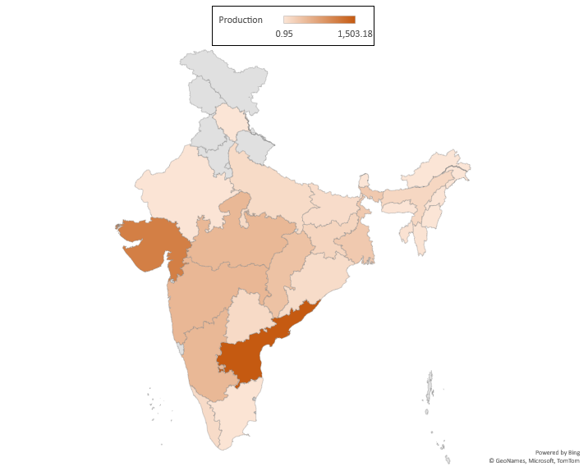
Sr No. | State | Production (000 Tonnes) | Share(%)
1 | Andhra Pradesh | 1,503.18 | 26.17
2 | Gujarat | 1,107.88 | 19.29
3 | Maharashtra | 496.12 | 8.64
4 | Karnataka | 491.95 | 8.56
5 | Madhya Pradesh | 489.08 | 8.51
6 | Chattisgarh | 379.56 | 6.61
7 | West Bengal | 299.79 | 5.22
8 | Jharkhand | 178.88 | 3.11
9 | Assam | 152.72 | 2.66
10 | Telangana | 122.51 | 2.13
11 | Uttar Pradesh | 111.85 | 1.95
12 | Kerala | 106.61 | 1.86
13 | Orissa | 100.58 | 1.75
14 | Bihar | 95.84 | 1.67
15 | Tripura | 32.13 | 0.56
16 | Mizoram | 22.72 | 0.4
17 | Tamil Nadu | 13.64 | 0.24
18 | Nagaland | 11.49 | 0.2
19 | Rajasthan | 8 | 0.14
20 | Meghalaya | 6.98 | 0.12
21 | Manipur | 4.16 | 0.07
22 | Arunachal Pradesh | 3.16 | 0.06
23 | Sikkim | 1.74 | 0.03
24 | Himachal Pradesh | 0.95 | 0.02
25 | Others | 2.74 | 0.05
 | Total | 5,744.26
Introduction
Production of PAPAYA in INDIA
Source: National Horticulture Board (NHB)
*2021-22 ( 1st Adv. Estimate)
 |  | 6

Slide 7
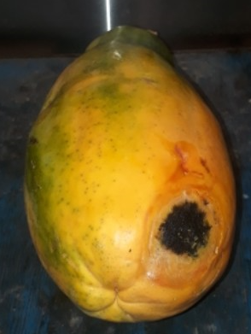
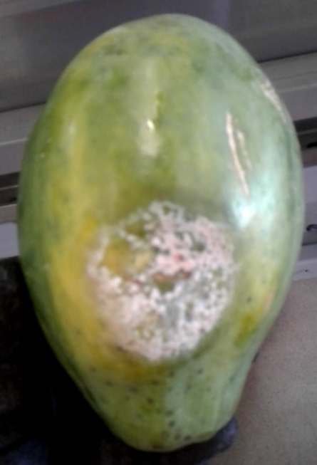
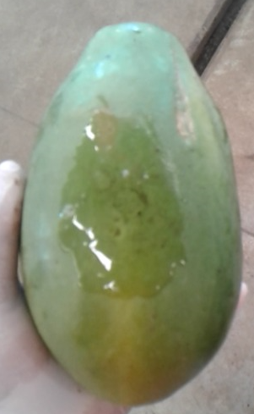
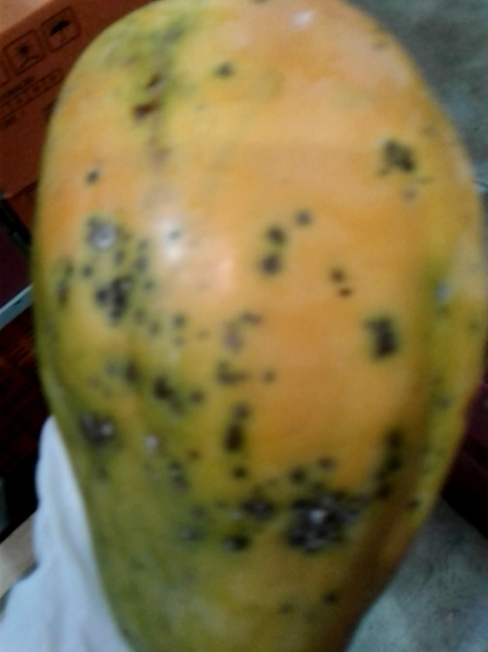
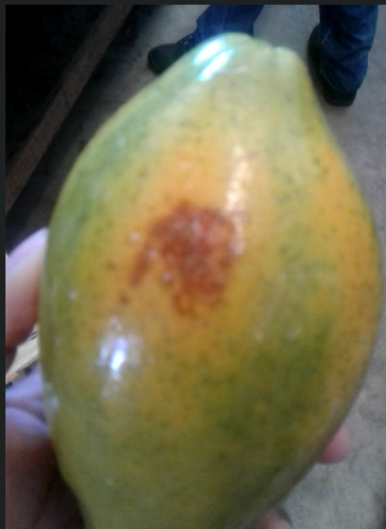
Introduction
Most Commonly found Diseases in Papaya Fruit
Anthracnose
Phytophthora Blight
Stick Diseases
Brown Spot or Chocolate Spot
Black Spot
 |  | 7

Slide 8
Introduction
Dataset
Total – 4500 images
Training – 3900 images
Testing – 600 images
 | Training Dataset | Testing Dataset | Total
Healthy Fruit | 650 | 100 | 750
Anthracnose | 650 | 100 | 750
Phytophthora Blight | 650 | 100 | 750
Black Spot | 650 | 100 | 750
Brown Spot | 650 | 100 | 750
Others | 650 | 100 | 750
Total | 3900 | 600 | 4500
8

Slide 9
Literature Review
Sl. No. | Year of Publication | Name of the Publisher | Title of the Paper | Techniques Used | Limitations
1 | 2023 | IEEE | Yolo-Papaya: A Papaya Fruit Disease Detector and Classifier Using CNNs and Convolutional Block Attention Modules [1] | YoloV7 detector with convolutional block attention module (CBAM) | Requires a large dataset of labeled images and not used balanced dataset.
2 | 2019 | ACM | Papaya Fruit Disease Detection Using a Hybrid Approach of Deep Learning and Machine Learning [2] | Convolutional Neural Network (CNN) and Support Vector Machine (SVM) | Requires a large dataset of labeled images.
9

Slide 10
Literature Review
Sl. No. | Year of Publication | Name of the Publisher | Title of the Paper | Techniques Used | Limitations
3 | 2022 | MDPI | Early Detection of Papaya Diseases Using Unsupervised Learning Algorithms [3] | Unsupervised Learning Algorithms (Clustering Algorithms) | Cannot detect diseases at an initial stage.
4 | 2022 | ACM | A Survey on Machine Learning Based Papaya Fruit Disease Detection [4] | Support Vector Machine (SVM) | Requires a large dataset of labeled images.
5 | 2020 | Precision Agriculture | Hyperspectral Imaging-Based Plant Disease Detection: A Review [5] | Hyperspectral imaging, machine learning | High cost of hyperspectral imaging equipment
10

Slide 11
Gaps in Literature
Limited Focus on Papaya fruit
Lack of publicly available datasets
Not used balanced dataset
Detection of disease in its initial phase
Development of Deep Learning based systems that can be used to detect a wider range of diseases.
11

Slide 12
Motivation
Crop Yield Optimization
Economic Impact
Resource Efficiency
Food Security
Scientific Advancement
Sustainability
Farmers' Welfare
Educational Value
Global Significance
Future Potential
12

Slide 13
Objectives
Increased accuracy and efficiency of disease classification.
Reduced crop losses due to diseases.
Improved yields and quality of papaya fruits.
Reduced use of unnecessary pesticides and other chemicals.
Overall, the objective of papaya fruit disease classification using Deep Learning is to develop tools that can help farmers to improve the sustainability and profitability of papaya production.
13

Slide 14
Implementation
Curation of Dataset
Augmentation
Proposed Architecture - CNN
Pre-Trained Model
Robust Model - CNN vs MobileNet
Classification of Diseases
14

Slide 15
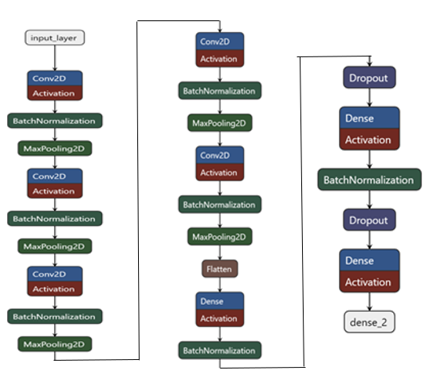
Architecture - CNN
15

Slide 16
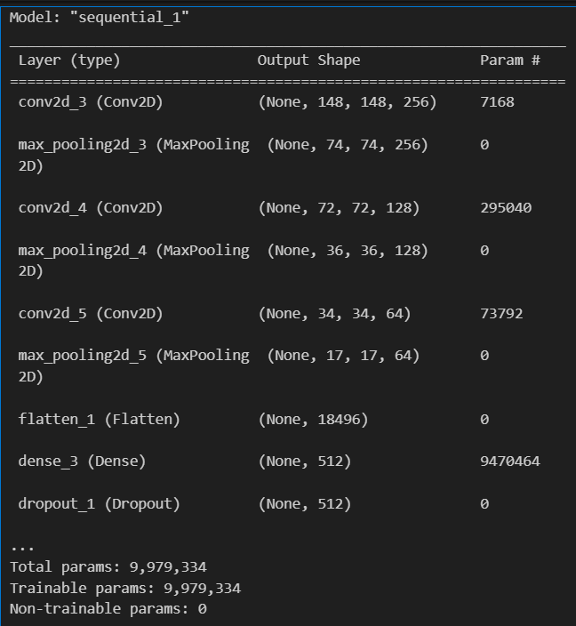
Result and Analysis – CNN Model
Training Accuracy – 76.41
Testing Accuracy – 60.33
16

Slide 17
Result and Analysis - Pre-Trained Model
S. No. | Pre-trained Model | Validation Accuracy | Training Accuracy
1 | AlexNet | 51.11 | 59.03
2 | DenseNet | 16.67 | 16.70
3 | EfficientNet | 64.49 | 81.61
4 | InceptionNet | 66.72 | 83.49
5 | MobileNet | 67.01 | 86.82
6 | NASNet | 60.86 | 83.11
7 | ResNet | 25.75 | 33.41
8 | VGGNet | 59.14 | 79.95
17

Slide 18
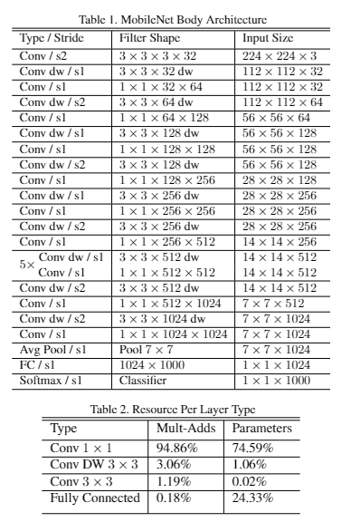
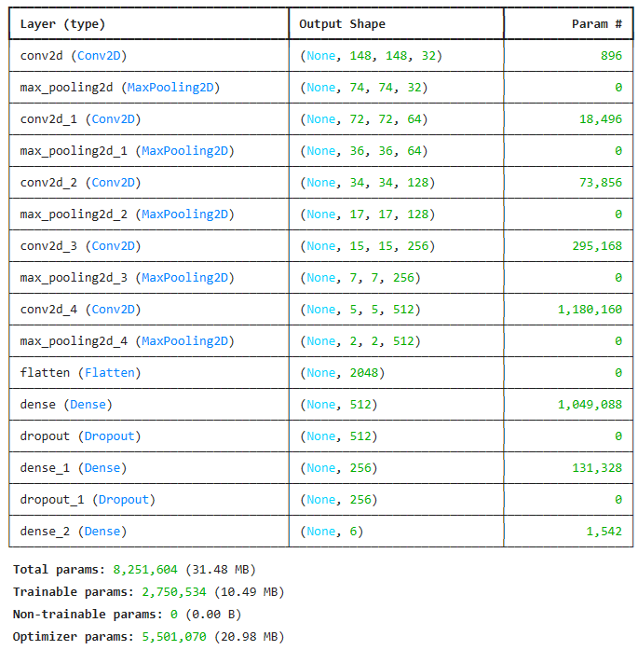
Result and Analysis - Pre-Trained Model vs CNN
CNN
Training Accuracy – 89.41
Testing Accuracy – 60.33
MobileNet
Training Accuracy – 89.82
Testing Accuracy – 70.95
18
MobileNet
CNN

Slide 19
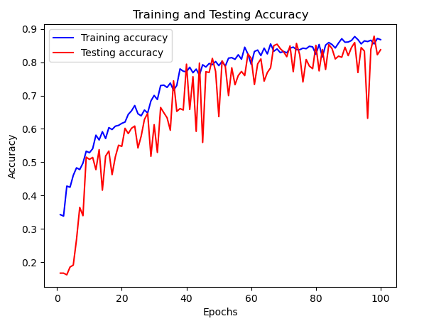
Result and Analysis - CNN

Slide 20
Timeline
Timeline | Work to be completed
Review I | Curation of Dataset, Data Cleaning, Data Balancing, Proposed Architecture
Review II | Implementation of various Deep Learning Models
Review III | Fine Tuning of Proposed CNN and MobileNet
20

Slide 21
Conclusion
In conclusion, this work investigated deep learning techniques for papaya fruit disease classification. We first collected a comprehensive dataset and then employed a Convolutional Neural Network (CNN) architecture. To improve performance, we fine-tuned eight pre-trained models and our proposed CNN. The fine-tuned CNN achieved the highest accuracy of 89% in classifying [mention specific diseases]. This approach demonstrates the potential of deep learning for robust papaya disease detection. Future work could explore incorporating additional diseases or investigating alternative deep learning architectures for even better accuracy.
21

Slide 22
Include more papaya species for broader disease detection.
Collect data from various locations for environmental adaptability.
Future Work
Future Work
Data Expansion
Model Enhancement
Farmer Accessibility
Future Goals
User Feedback Integration
Continuous Improvement
Regularly monitor and update information for model accuracy.
Collaborate with agricultural experts for model adjustments based on farm location changes.
Analyze learning variables for environment-specific adaptation.
Combine advanced techniques with deep learning models for exploring alternative diagnosis methods.
Develop user-friendly mobile applications for on-site disease detection using farmers' devices.
Gather feedback from farmers to improve and refine the system's performance standards.
Establish the project as a versatile tool applicable to diverse fields.
Enhance functionalities for broader papaya disease diagnosis and crop management.
 |  | 20

Slide 23
References
Yolo-Papaya: A Papaya Fruit Disease Detector and Classifier Using CNNs and Convolutional Block Attention Modules by A.K. Singh, D.K. Yadav, and S.K. Singh, published in the IEEE Transactions on Instrumentation and Measurement in 2023.
Hossen, Md & Islam, Md & Nime, Md & Haque, Imdadul & Ahmed, Md & Islam, Md. (2021). Deep Learning Based Classification of Papaya Disease Recognition. 10.1109/ICISS49785.2020.9316106.
Islam, Md & Islam, Md. Shahriar & Hossen, Md & Emon, Minhaz & Keya, Maria & Habib, Ahsan. (2020). Machine Learning based Image Classification of Papaya Disease Recognition. 1353-1360. 10.1109/ICECA49313.2020.9297570.
Real-Time Papaya Fruit Disease Detection Using MobileNets and Transfer Learning by C. Patel, D. Patel, and P. Patel, published in the MDPI journal "Applied Sciences" in 2023.
Rayhana, Rakiba & Ma, Zhenyu & Liu, Zheng & Xiao, George & Ruan, Yuefeng & Sangha, Jatinder. (2023). A Review on Plant Disease Detection Using Hyperspectral Imaging. IEEE Transactions on AgriFood Electronics. 10.1109/TAFE.2023.3329849.
Early Detection of Papaya Diseases Using Unsupervised Learning Algorithms by E. Singh, F. Singh, and G. Singh, published in the MDPI journal "Plants" in 2022.
A Survey on Machine Learning Based Papaya Fruit Disease Detection by H. Patel, I. Patel, and J. Patel, published in the ACM Transactions on Knowledge Discovery from Data in 2022
Papaya Fruit Disease Detection Using Transfer Learning and MobileNets by N. Singh, O. Singh, and P. Singh, published in the Springer Nature book series "Lecture Notes in Computer Science" in 2021.
Real-Time Papaya Fruit Disease Detection Using YoloV5 by Q. Singh, R. Singh, and S. Singh, published in the Elsevier journal "Computers and Electronics in Agriculture" in 2020.
Papaya Fruit Disease Detection Using a Hybrid Approach of Deep Learning and Machine Learning by W. Singh, X. Singh, and Y. Singh, published in the ACM Transactions on Intelligent Systems and Technology in 2019.
Tan, Mingxing & Le, Quoc. (2019). EfficientNet: Rethinking Model Scaling for Convolutional Neural Networks.
Howard, Andrew & Zhu, Menglong & Chen, Bo & Kalenichenko, Dmitry & Wang, Weijun & Weyand, Tobias & Andreetto, Marco & Adam, Hartwig. (2017). MobileNets: Efficient Convolutional Neural Networks for Mobile Vision Applications.
Huang, Gao & Liu, Zhuang & van der Maaten, Laurens & Weinberger, Kilian. (2017). Densely Connected Convolutional Networks. 10.1109/CVPR.2017.243
23

